Slide 1
Sons of God: Building the House of God
Luke 7:1-10
23/07/17

Slide 2

Acts 13:22
And when He had removed him,
He raised up for them David as king,
to whom also He gave testimony and said,
‘I have found David the son of Jesse,
a man after My own heart,
who will do all My will.

Slide 3
1 Chro 29:1-3
Furthermore King David said to all the assembly: “My son Solomon, whom alone God has chosen, is young and inexperienced; and the work is great, because the temple is not for man but for the Lord God. Now for the house of my God I have prepared with all my might: gold for things to be made of gold, silver for things of silver, bronze for things of bronze, iron for things of iron, wood for things of wood, onyx stones, stones to be set, glistening stones of various colors, all kinds of precious stones, and marble slabs in abundance. Moreover, because I have set my affection on the house of my God, I have given to the house of my God, over and above all that I have prepared for the holy house, my own special treasure of gold and silver:

Slide 4
CHURCH UNUSUAL!
  A habitation for God to move, manifest and transact freely & fully
God’s “dwelling” on earth
Heb 3:6 but Christ is faithful over God's house as a son. And we are his house, if indeed we hold fast our confidence and our boasting in our hope.
God’s “dwelling” in us
1 Cor 6:19-20 Or do you not know that your body is a temple of the Holy Spirit in you, whom you have of God? And you are not your own, for you are bought with a price. Therefore glorify God in your body and in your spirit, which are God’s.

Slide 5
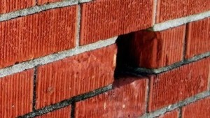
1 Pet 2:1-5
Therefore, laying aside all malice, all deceit, hypocrisy, envy, and all evil speaking, as newborn babes, desire the pure milk of the word, that you may grow thereby, if indeed you have tasted that the Lord is gracious.
Coming to Him as to a living stone, rejected indeed by men, but chosen by God and precious, you also, as living stones, are being built up a spiritual house, a holy priesthood, to offer up spiritual sacrifices acceptable to God through Jesus Christ.

Slide 6
Building His House
David (1 Chro 29:3)
- Release finances and resources
*If we build His House, He will build ours
1 Kings 17:23-26
Generational blessing

Slide 7
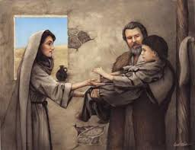
Building His House
2) The Shunammite woman (2 King 4:8-37)
- “let us make a small upper room…”
- Open her house for God’s purpose and for man representing God.
v16 *Prophetic Word (blessing) released
“At this season, about this time next year, you shall embrace a son”
v35 *Healing released

Slide 8
Building His House
3) The midwives in Egypt (Exo 1:17-21)
- Feared God and protected God’s people
*God gave them households (families)

Slide 9
Building His House
4) The Israelites who returned to Jerusalem (by Cyrus) to rebuild the temple Hag 1:2-11 – Use the resources to build their own house.
*Hag 2:18-19 The moment we build His house, something has already started in the spiritual realm (seed planted).

Slide 10
Building His House
5) The Centurion (Luke 7:1-10)
- “he loves our nation, and he is the one who built us our synagogue.”
*Jesus was moved and released blessing to him (a Gentile) even though it was not time for the Gentiles yet.

Slide 11
Blessings on the Centurion
His investment in God’s house gave him drawing rights when he needed it. He already done something (Proactive).
- History of obedience with God.
Heb 6:10 - For God is not unjust to forget your work and labour of love which you have shown toward His name, in that you have ministered to the saints, and do minister.

Slide 12
Blessings on the Centurion
2. He reached into tomorrow and got his inheritance ‘earlier’.
- It was not yet for him (a Gentile) but he was able to pull it into his day.
Matt 15:21-28 Jesus healed a woman from Canaan (a Gentile) for her great faith.

Slide 13
Blessings on the Centurion
3. He experienced unlimited favour.
The Jews (who did not like the Romans) pleaded with Jesus
Connect to the right people = essential to success.

Slide 14
Blessings on the Centurion
4. He had revelation of mysteries and divine law. He understood the principle of chain of authority.
5. His house experienced healing.
Healing came into his house because he build God’s house.
Not only those under your house but those connected to you.
Generational healing

Slide 15
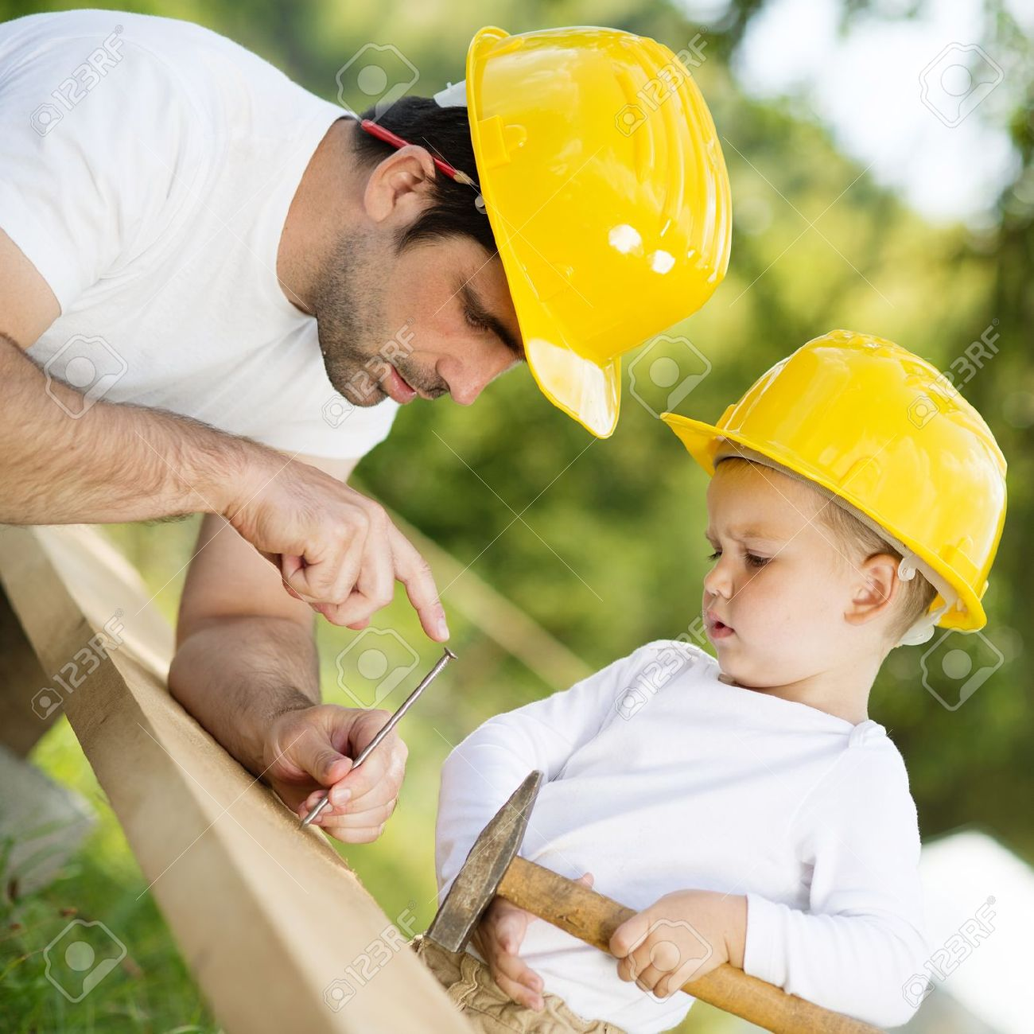
God’s house
God looks highly of people who build His house, a place for God’s people to worship Him
We are not only part
of the House but we
are also building the
House

Slide 16

Sow the seeds now
God loves those who build His house!
Be ready for the miracle
True sons of the House…

